Slide 1
Advanced Robotics Project Submission
Vladimir Klepikov, Oleg Ostapovich

Slide 2
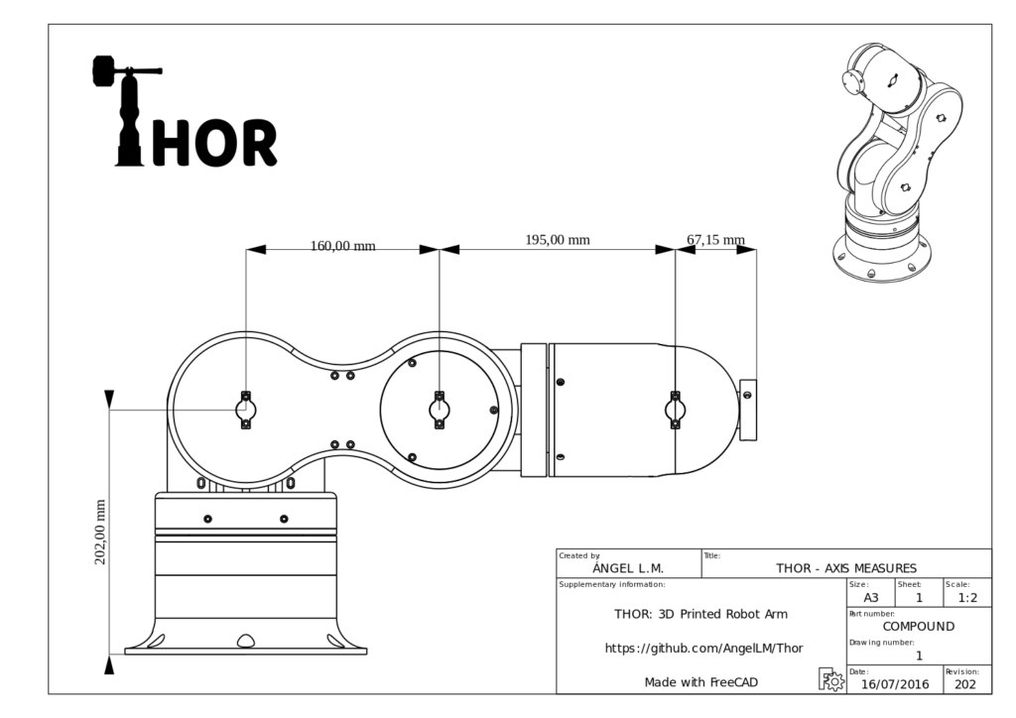
Chosen model

Slide 3
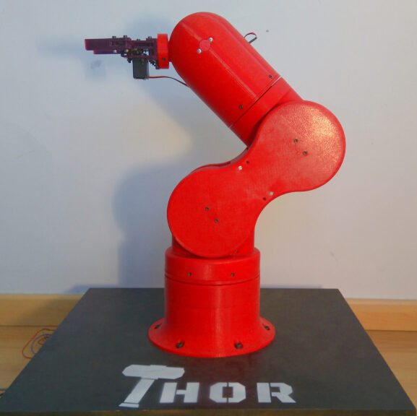
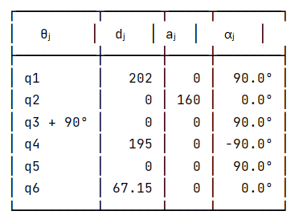
About Model
All joints are revolute
DH parameters:

Slide 4
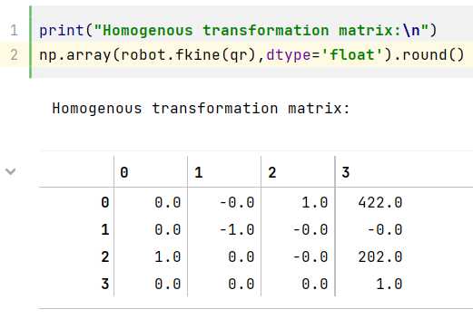
Forward Kinematics

Slide 5
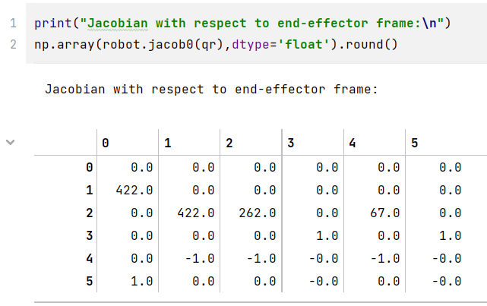
Jacobian

Slide 6
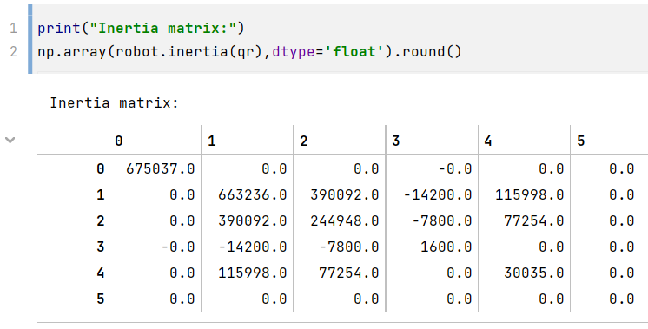
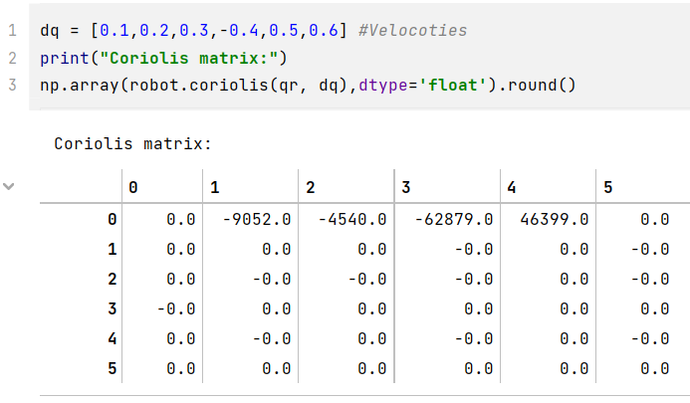
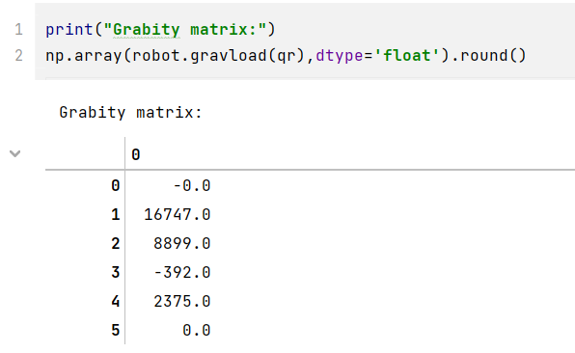
Dynamics
Inertia matrix:
Coriolis matrix:
Gravity matrix:

Slide 7
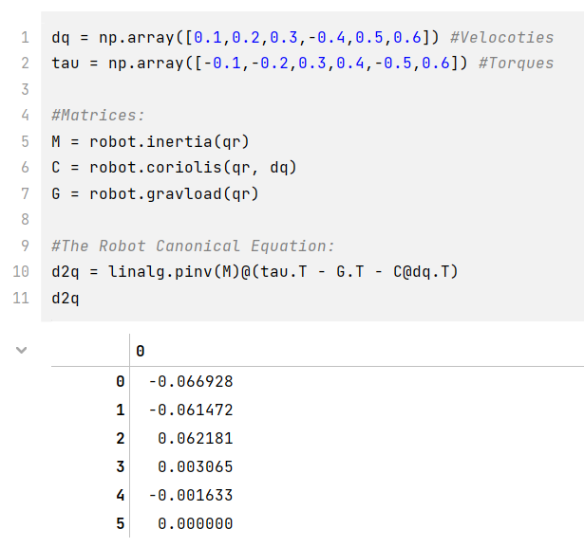
Dynamics

Slide 8

That’s all

